Slide 1
Multimodal Transit Corridor
Team: 1. G Saketh
2. G Pavan
3. P Jaswanth
4. K Duwarkesh

Slide 2
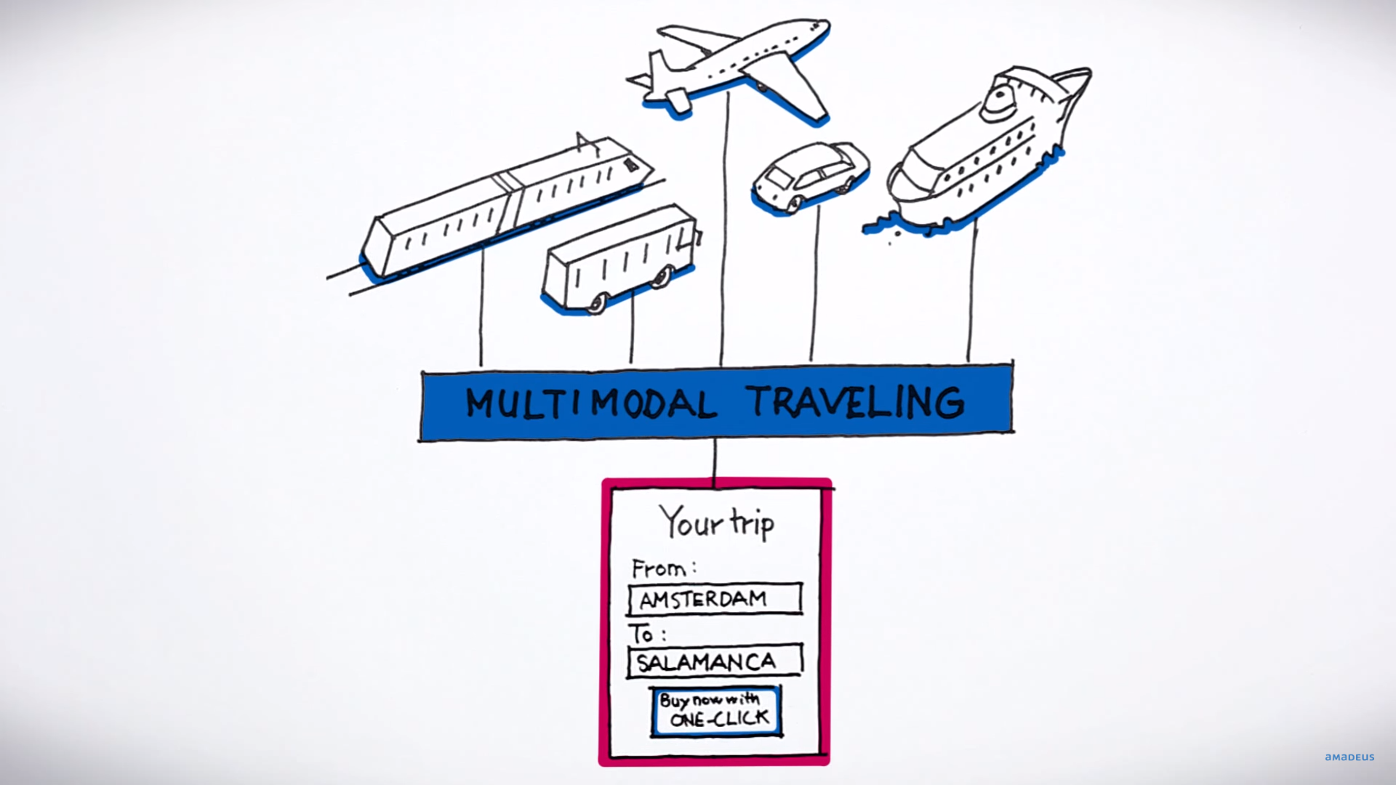
Arranging your trip/ journey in easy and convenient manner (on one click)

Slide 3

Gives the exact and the most efficient route

Slide 4
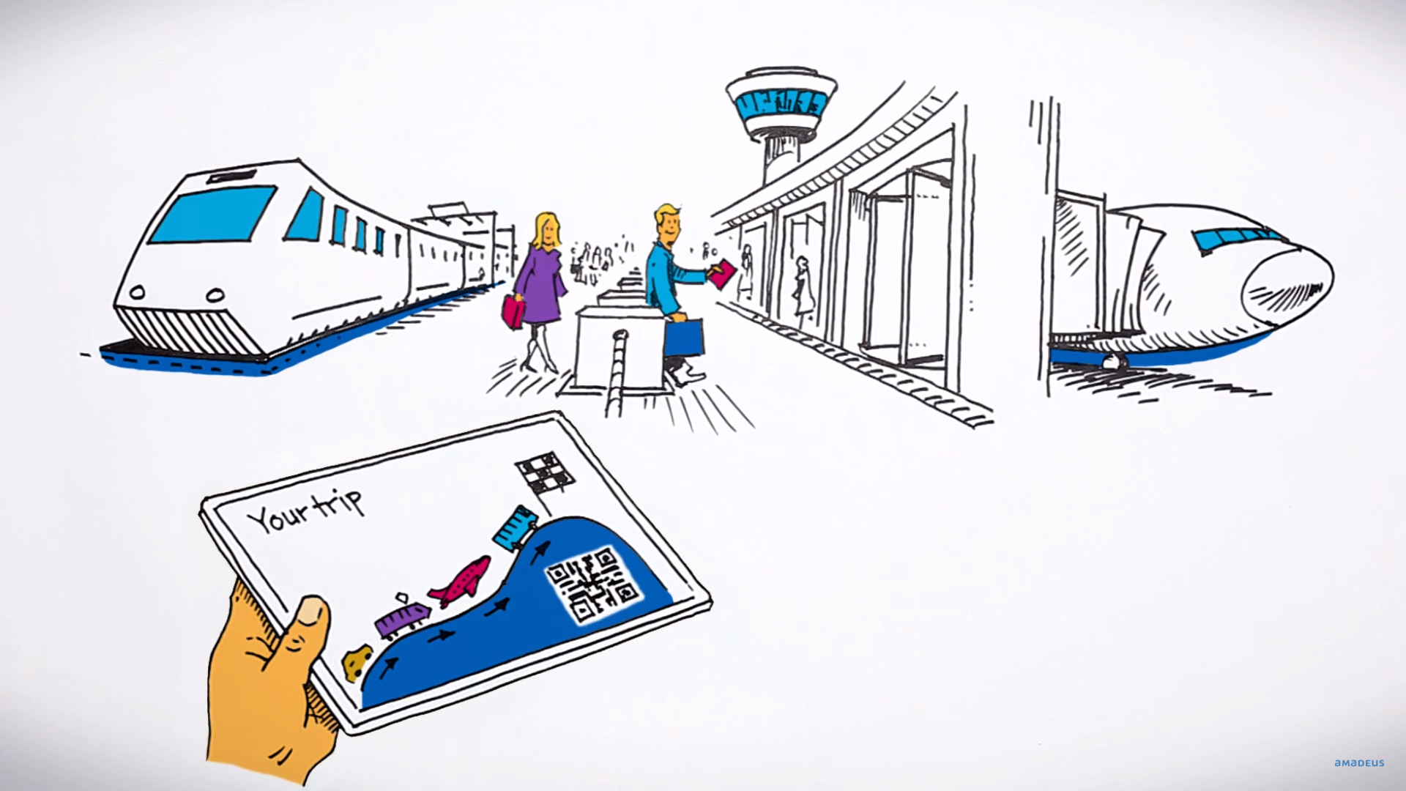
One time booking of the ticket for multiple destinations through different modes of transports from door to door.

Slide 5
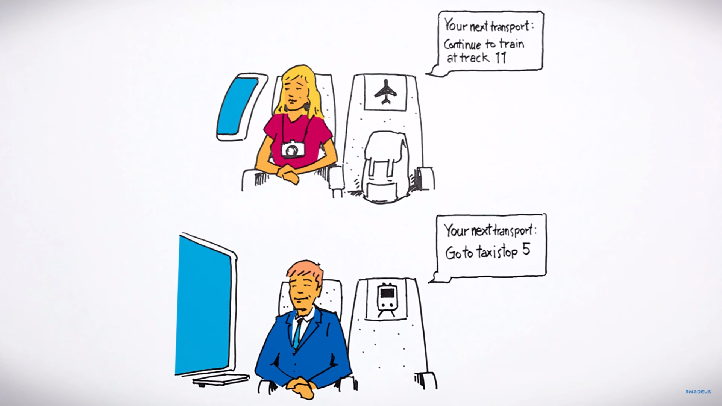
Booking of ticket based on our budget and requirement is made easy and also notifies about the next arrival details

Slide 6
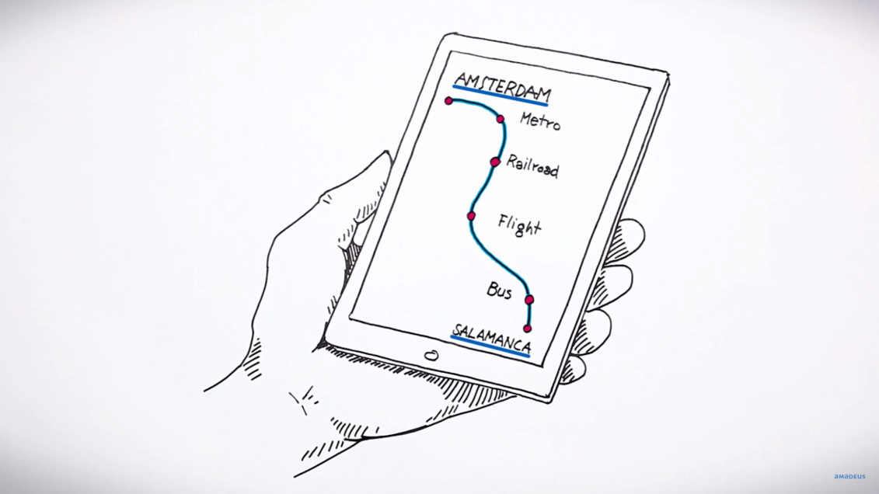
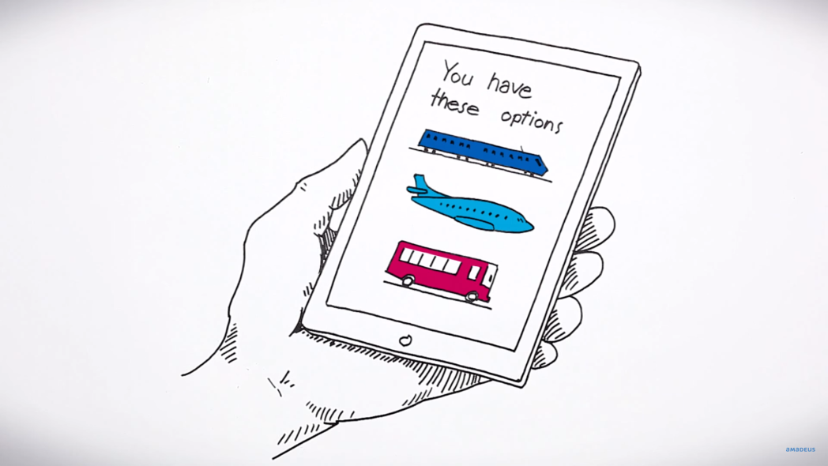
Know the information of the different routes available to our destination through different transports

Slide 7
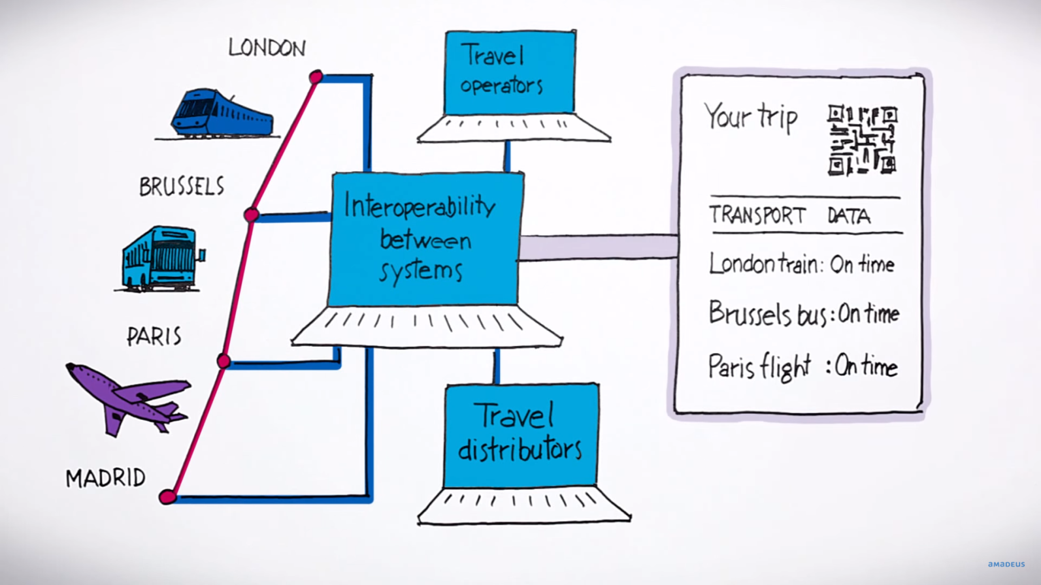
Instant provision of the alternate mode of transport during any type of inconvenience (delay or cancellation of the arranged transport mode)

Slide 8
THANK YOU

